Slide 1
BM Project – Human Data Update 2
Macrophage Sub-clustering | GSE266330 | ER status from patient metadata
Jianting Sheng | Houston Methodist Neal Cancer Center

Slide 2
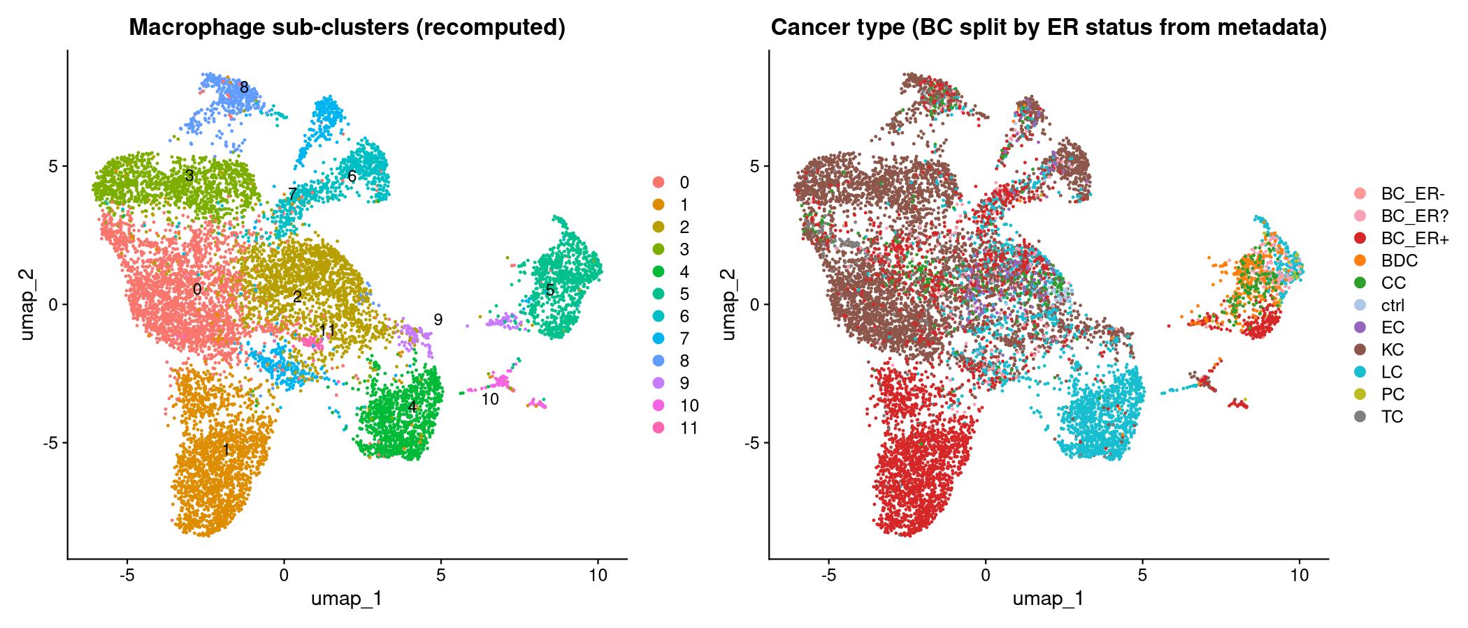
Macrophage Sub-clustering (UMAP)
Full recompute: SCTransform → PCA → UMAP → FindClusters | GSE266330, Liu et al. 2025

Slide 3
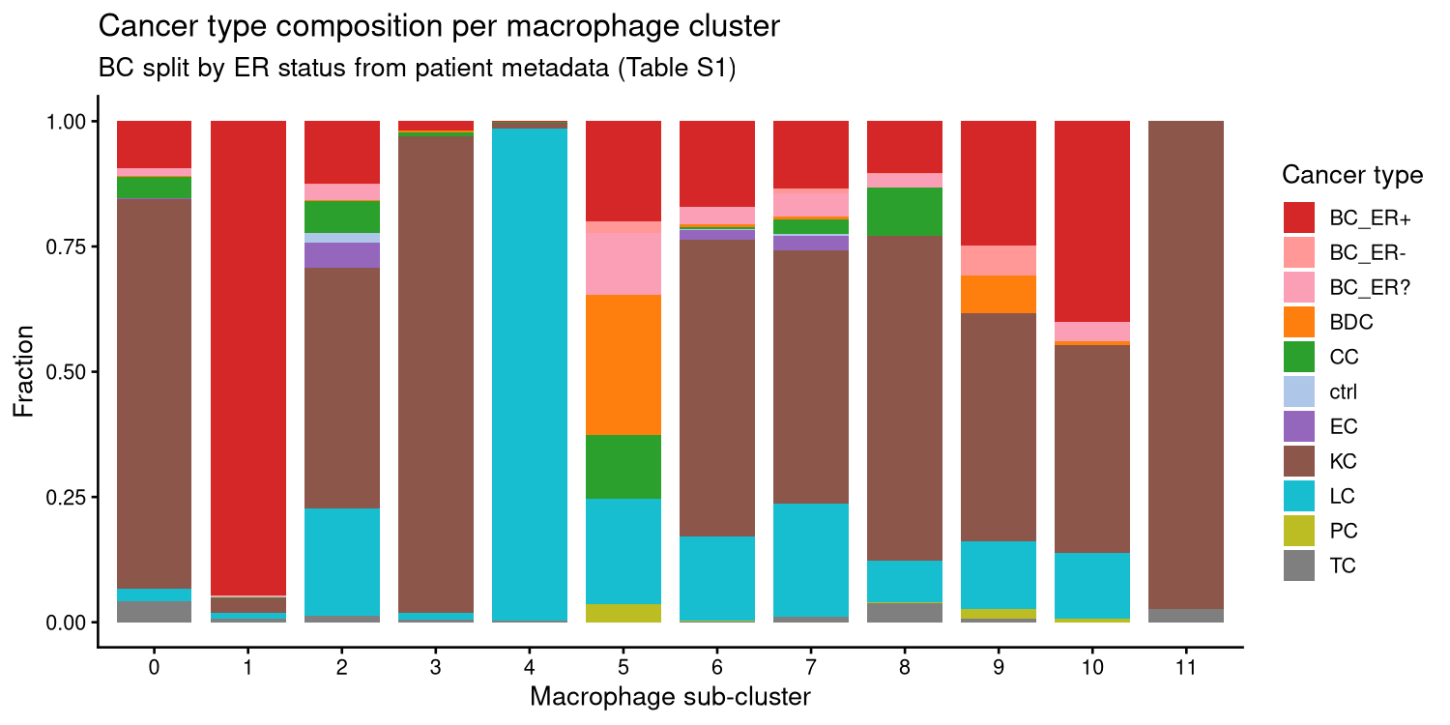
Cancer Type Composition per Macrophage Cluster
BC split by ER status from patient metadata (Table S1)

Slide 4
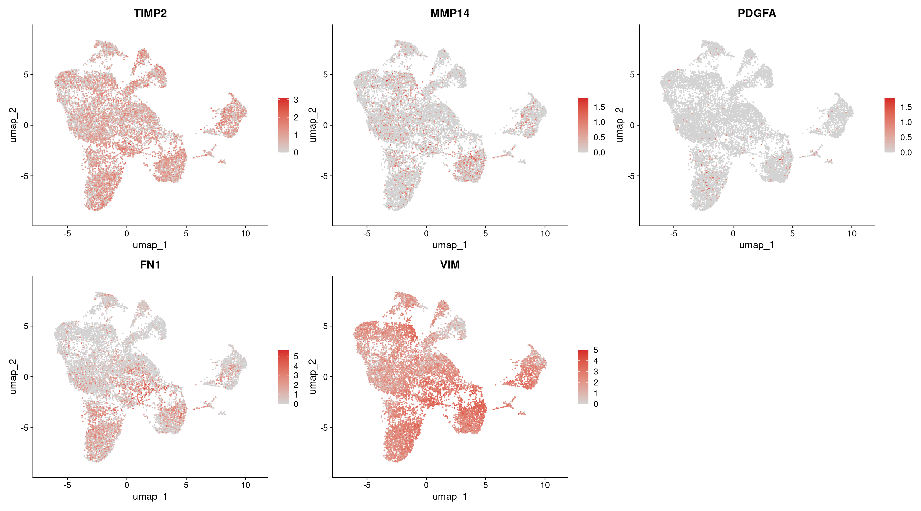
Highlight Gene Feature Plots — UMAP
Genes: Timp2 / Mmp14 / Pdgfa / Fn1 / Vim

Slide 5
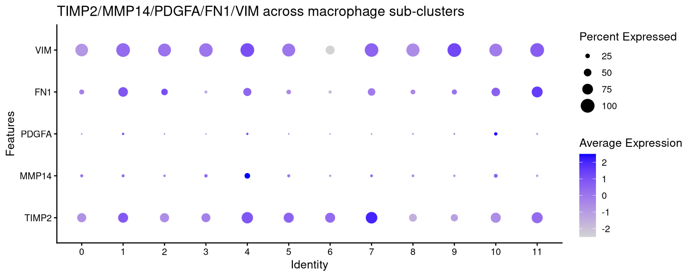
Highlight Gene Dot Plot — per Macrophage Sub-cluster
Genes: Timp2 / Mmp14 / Pdgfa / Fn1 / Vim | Dot size = % expressing; color = avg expression

Slide 6
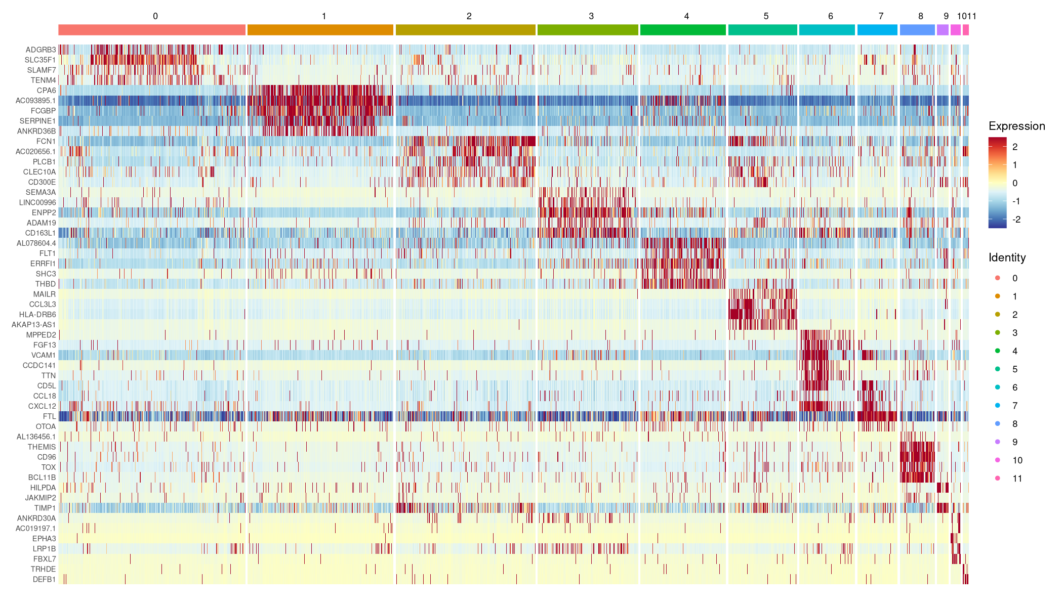
DEG Heatmap — Top 5 Marker Genes per Cluster
FindAllMarkers (Wilcoxon) | only.pos=TRUE | min.pct=0.25 | padj<0.05

Slide 7
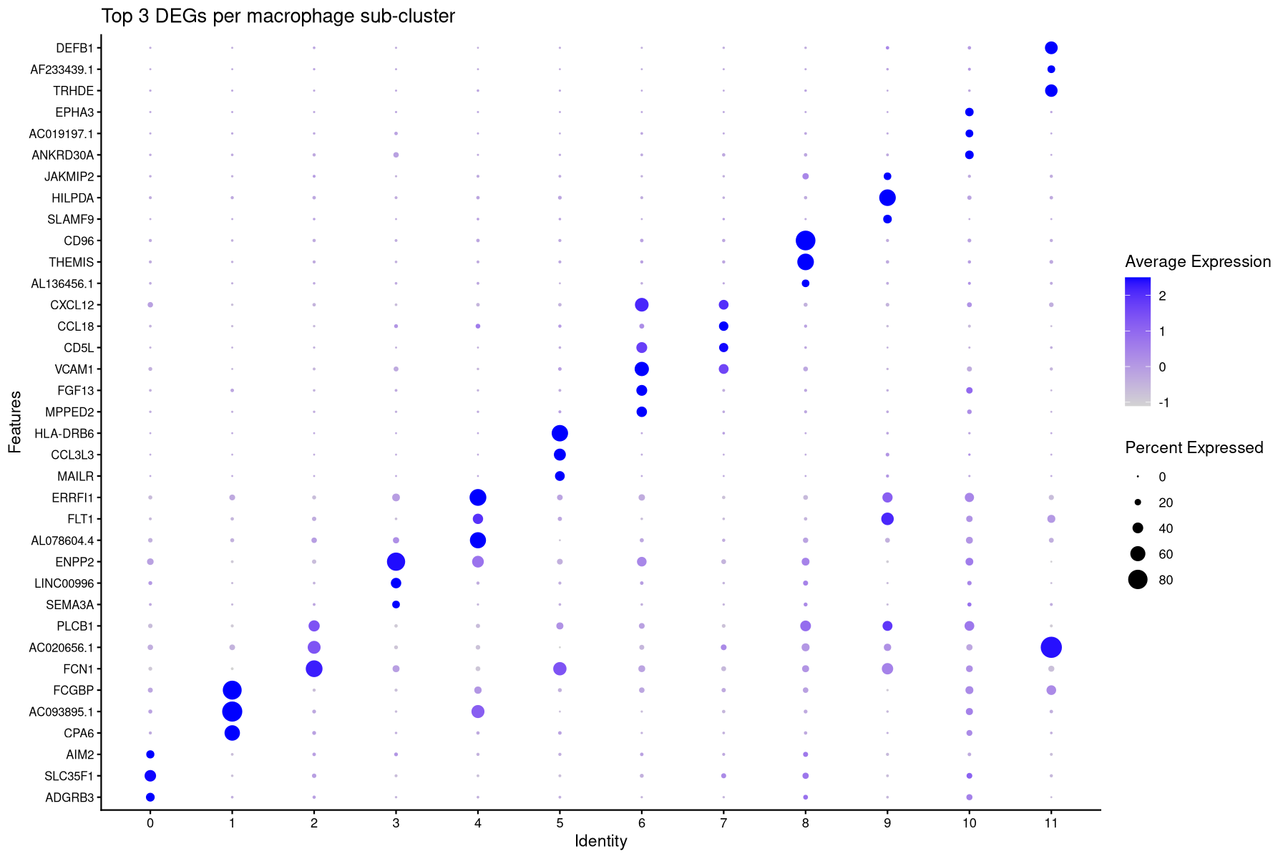
DEG Dot Plot — Top 3 Marker Genes per Cluster
Dot size = % cells expressing; color = average expression

Slide 8
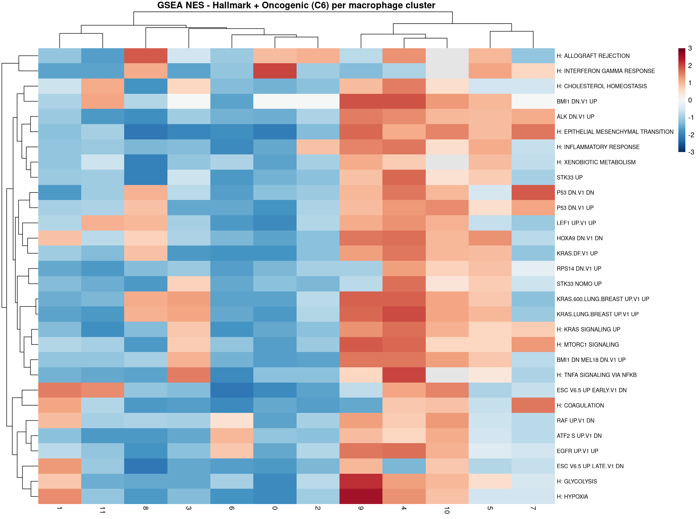
GSEA — Hallmark + Oncogenic (C6) NES Heatmap
fgsea | MSigDB Hallmark (H) + Oncogenic Signatures (C6) | HVGs only | color = NES

Slide 9
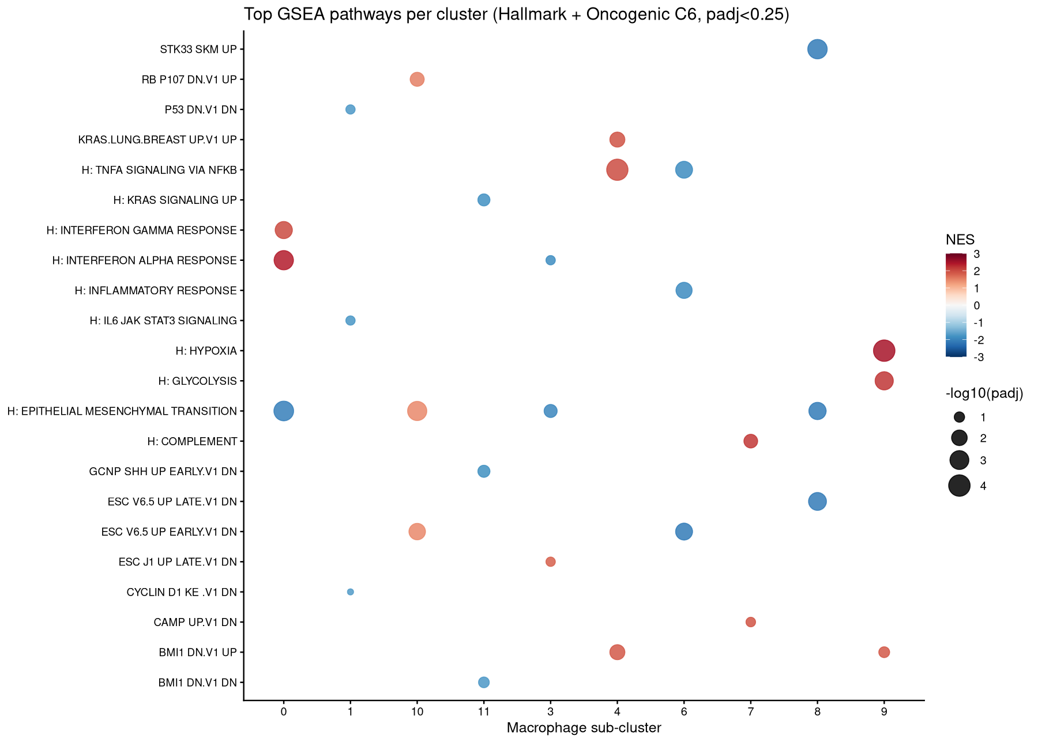
GSEA — Top Pathways per Cluster (Bubble Plot)
Top 3 pathways per cluster (padj<0.25) | size = −log₁₀(padj) | color = NES

Slide 10
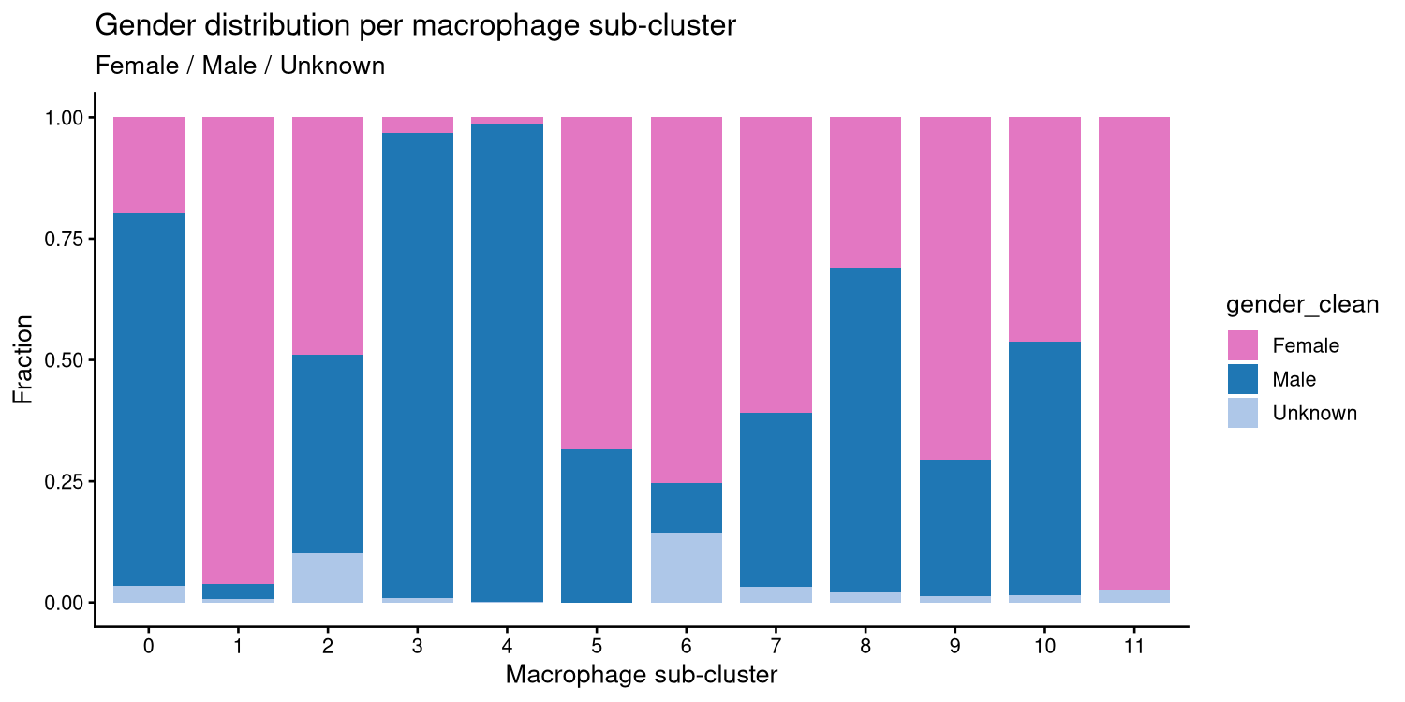
Gender Distribution per Macrophage Sub-cluster
Female / Male / Unknown fraction per cluster

Slide 11
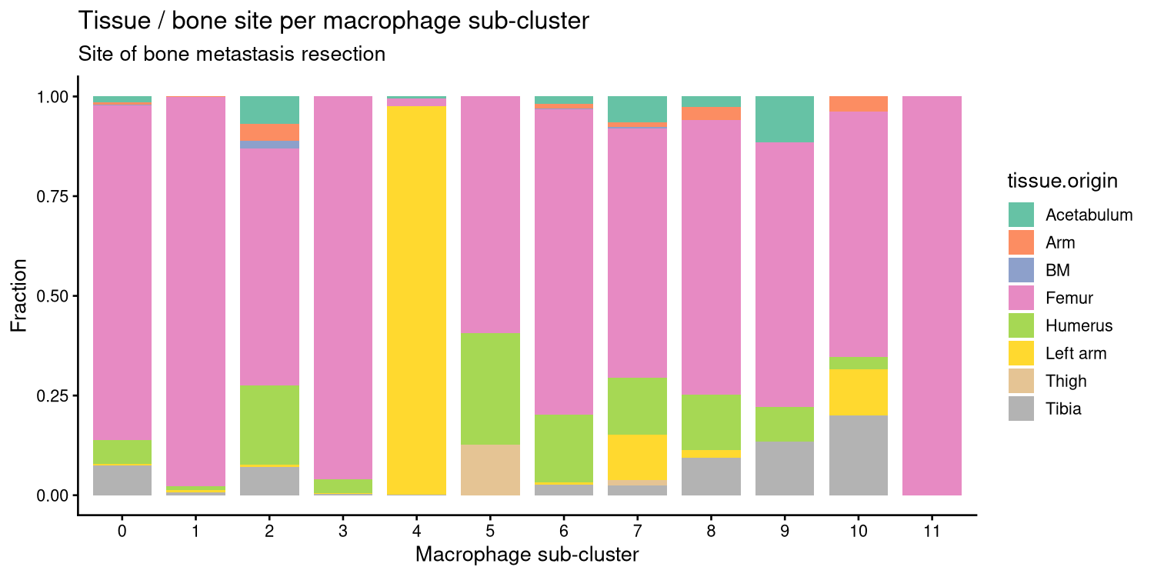
Bone Site / Tissue Origin per Macrophage Sub-cluster
Site of bone metastasis resection

Slide 12
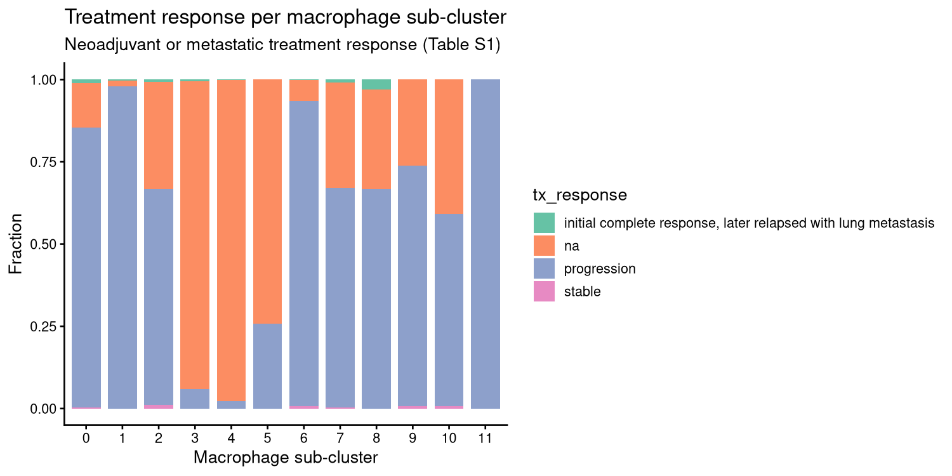
Treatment Response per Macrophage Sub-cluster
Neoadjuvant or metastatic treatment response (Table S1)

Slide 13
Summary & Next Steps
Update 2 — key changes
• ER+/ER- from patient metadata (Table S1)
• Marker genes: highlight_genes.txt
– Timp2 / Mmp14 / Pdgfa / Fn1 / Vim
• DEG: FindAllMarkers per cluster
• GSEA: Hallmark + Oncogenic (C6)
– HVGs only for speed
• Metadata: gender / bone site / treatment
– Cluster 11 = highlight-gene-high
Next steps
• Annotate clusters with canonical markers
– Cross-ref Yuliang’s signature
• Link highlight-gene-high cluster
– to S2C2 crosstalk model
• Validate in mouse scRNA (Jianting W2/W3)
• Drug target screen on top cluster

